Slide 1

PYTHON DICTIONARIES

Slide 2
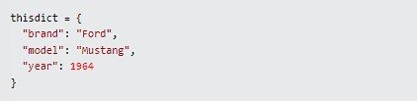
DICTIONARY
Dictionaries are used to store data values in key:value pairs.
A dictionary is a collection which is ordered*, changeable and do not allow duplicates.

Slide 3

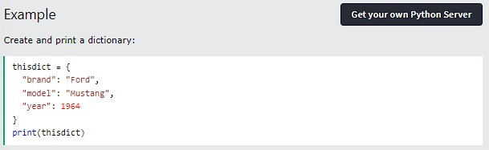
Dictionaries are written with curly brackets, and have keys and values:

Slide 4

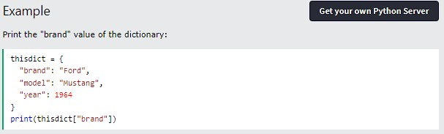
DICTIONARY ITEMS
Dictionary items are ordered, changeable, and does not allow duplicates.
Dictionary items are presented in key:value pairs, and can be referred to by using the key name.

Slide 5
ORDERED OR UNORDERED?
When we say that dictionaries are ordered, it means that the items have a defined order, and that order will not change. Unordered means that the items does not have a defined order, you cannot refer to an item by using an index.
CHANGEABLE
Dictionaries are changeable, meaning that we can change, add or remove items after the dictionary has been created.

Slide 6
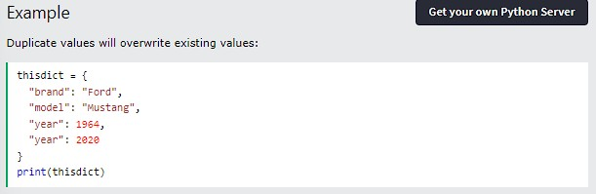
DUPLICATES NOT ALLOWED
Dictionaries cannot have two items with the same key:

Slide 7
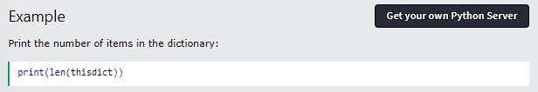
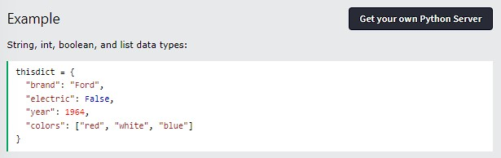
DICTIONARY LENGTH
To determine how many items a dictionary has, use the len() function:
DICTIONARY ITEMS - DATA TYPES
The values in dictionary items can be of any data type:

Slide 8

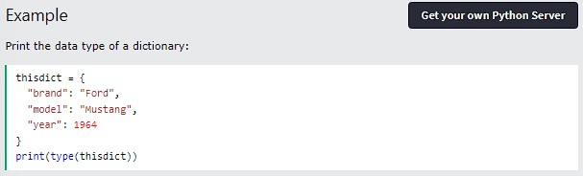
TYPE()
From Python's perspective, dictionaries are defined as objects with the data type 'dict':

Slide 9
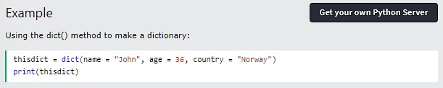
THE DICT() CONSTRUCTOR
It is also possible to use the dict() constructor to make a dictionary.

Slide 10
PYTHON COLLECTIONS (ARRAYS)
There are four collection data types in the Python programming language:
List is a collection which is ordered and changeable. Allows duplicate members.
Tuple is a collection which is ordered and unchangeable. Allows duplicate members.
Set is a collection which is unordered, unchangeable*, and unindexed. No duplicate members.
Dictionary is a collection which is ordered** and changeable. No duplicate members.
When choosing a collection type, it is useful to understand the properties of that type. Choosing the right type for a particular data set could mean retention of meaning, and, it could mean an increase in efficiency or security.

Slide 11
THANK YOU

Slide 12
Python
Access Dictionary Items

Slide 13
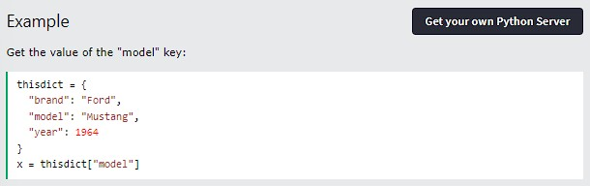
Accessing Items
Python - Dictionaries - Access Dictionary Items
You can access the items of a dictionary by referring to its key name, inside square brackets:

Slide 14
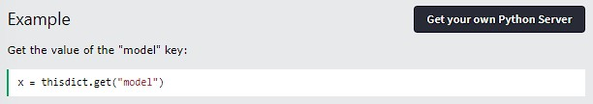
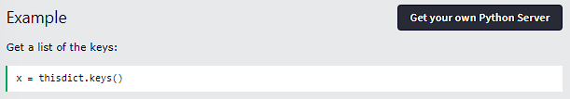
There is also a method called get() that will give you the same result:
Python - Dictionaries - Access Dictionary Items
Get Keys
The keys() method will return a list of all the keys in the dictionary.

Slide 15
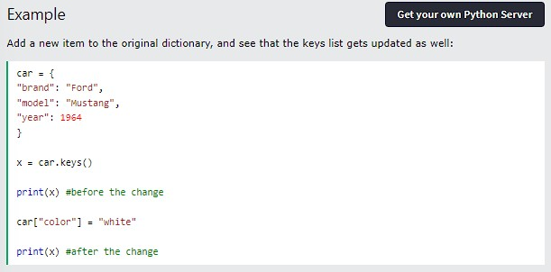
The list of the keys is a view of the dictionary, meaning that any changes done to the dictionary will be reflected in the keys list.
Python - Dictionaries - Access Dictionary Items

Slide 16
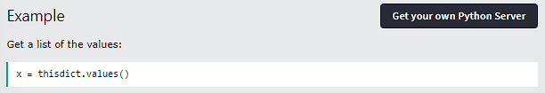
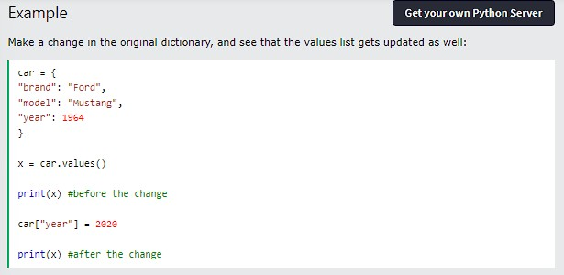

Get Values
The values() method will return a list of all the values in the dictionary.
Python - Dictionaries - Access Dictionary Items
The list of the values is a view of the dictionary, meaning that any changes done to the dictionary will be reflected in the values list.

Slide 17
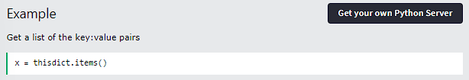

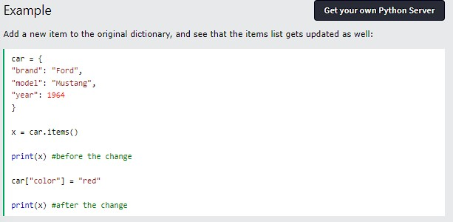
Get Items
The items() method will return each item in a dictionary, as tuples in a list.
Python - Dictionaries - Access Dictionary Items
The returned list is a view of the items of the dictionary, meaning that any changes done to the dictionary will be reflected in the items list.

Slide 18
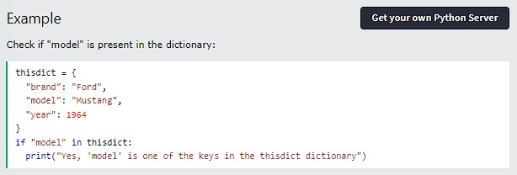
Check if Key Exists
Python - Dictionaries - Access Dictionary Items
To determine if a specified key is present in a dictionary use the in keyword:

Slide 19
Thank you
Python - Dictionaries - Access Dictionary Items

Slide 20

PYTHON - CHANGE DICTIONARY ITEMS

Slide 21

CHANGE VALUES
The update() method will update the dictionary with the items from the given argument. The argument must be a dictionary, or an iterable object with key:value pairs.

Slide 22
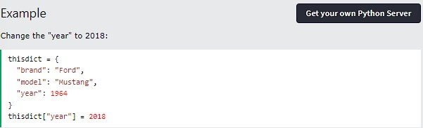
UPDATE DICTIONARY
You can change the value of a specific item by referring to its key name:

Slide 23
UPDATE DICTIONARY
You can change the value of a specific item by referring to its key name:

Slide 24

THANK YOU

Slide 25
Python
Add Dictionary Items

Slide 26
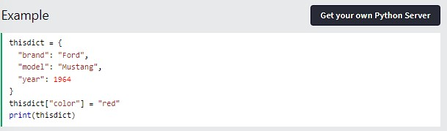
Adding Items
Python - Dictionaries - Add Dictionary Items
Adding an item to the dictionary is done by using a new index key and assigning a value to it:

Slide 27
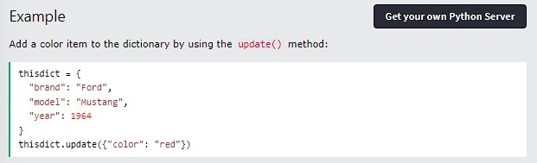
Update Dictionary
The update() method will update the dictionary with the items from a given argument. If the item does not exist, the item will be added.
The argument must be a dictionary, or an iterable object with key:value pairs.
Python - Dictionaries - Add Dictionary Items

Slide 28
Thank you
Python - Dictionaries - Add Dictionary Items

Slide 29
Python
Remove Dictionary Items

Slide 30
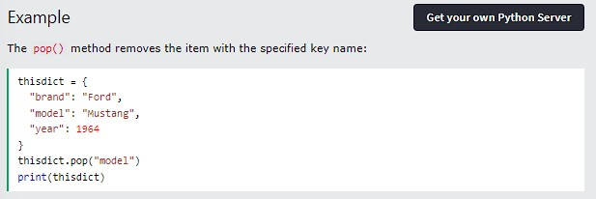
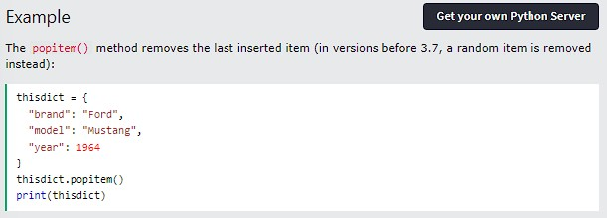
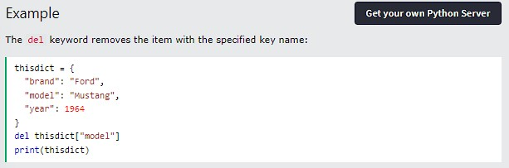
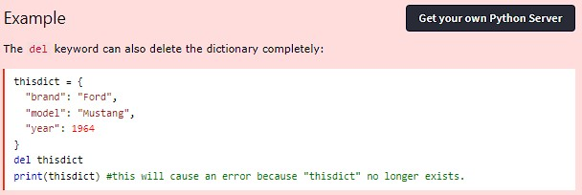
Removing Items
Python - Dictionaries -Remove Dictionary Items
There are several methods to remove items from a dictionary:

Slide 31
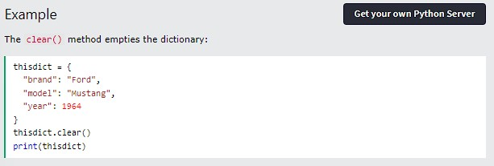
Removing Items
Python - Dictionaries -Remove Dictionary Items

Slide 32
Thank you
Python - Dictionaries -Remove Dictionary Items

Slide 33

PYTHON LOOP DICTIONARIES

Slide 34
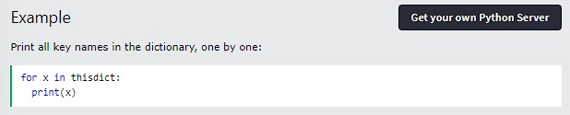
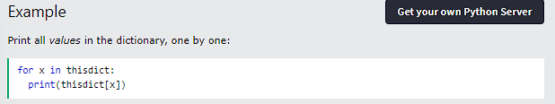
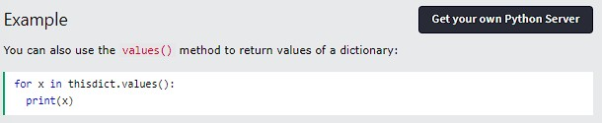
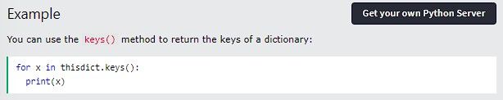
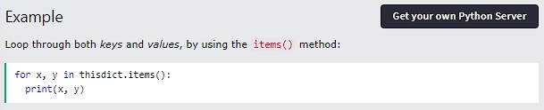
LOOP THROUGH A DICTIONARY
You can loop through a dictionary by using a for loop.
When looping through a dictionary, the return value are the keys of the dictionary, but there are methods to return the values as well.

Slide 35
THANK YOU

Slide 36
Python
Copy Dictionaries

Slide 37
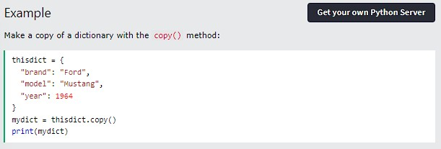
Copy a Dictionary
You cannot copy a dictionary simply by typing dict2 = dict1, because: dict2 will only be a reference to dict1, and changes made in dict1 will automatically also be made in dict2.
There are ways to make a copy, one way is to use the built-in Dictionary method copy().
Python - Dictionaries - Copy Dictionaries

Slide 38
Another way to make a copy is to use the built-in function dict().
Python - Dictionaries - Copy Dictionaries

Slide 39
Thank you
Python - Dictionaries -Remove Dictionary Items

Slide 40
PYTHON - NESTED DICTIONARIES

Slide 41
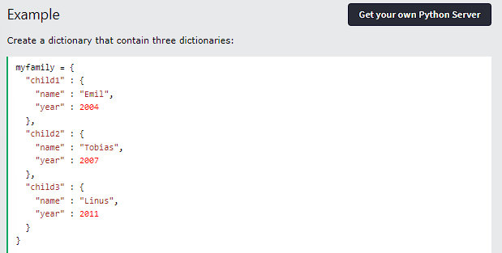
NESTED DICTIONARIES
A dictionary can contain dictionaries, this is called nested dictionaries.

Slide 42
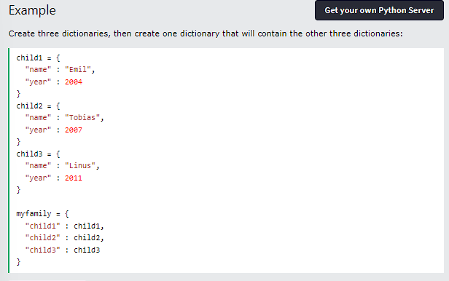
Or, if you want to add three dictionaries into a new dictionary:

Slide 43
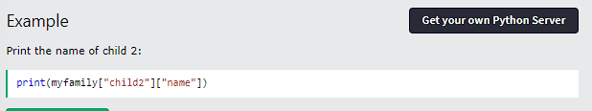
ACCESS ITEMS IN NESTED DICTIONARIES
To access items from a nested dictionary, you use the name of the dictionaries, starting with the outer dictionary:

Slide 44
THANK YOU

Slide 45
Python
Dictionary Methods

Slide 46
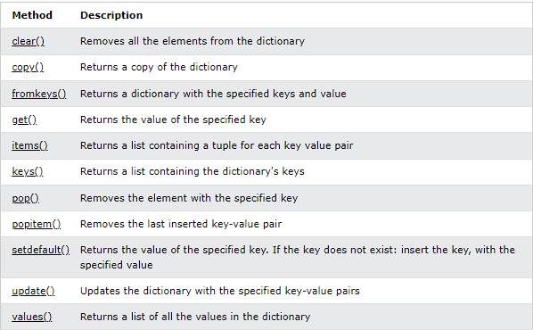
Dictionary Methods
Python has a set of built-in methods that you can use on dictionaries.
Python - Dictionaries - Dictionary Methods

Slide 47
Thank you
Python - Dictionaries -Remove Dictionary Items

Slide 48
Python
Dictionary Exercises

Slide 49
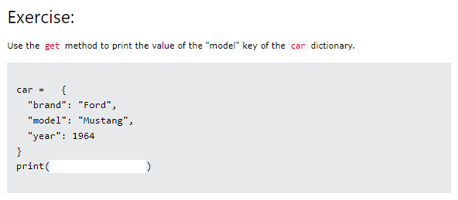
Test Yourself With Exercises
Python - Dictionaries - Dictionary Exercises
Now you have learned a lot about dictionaries, and how to use them in Python. Are you ready for a test?
Try to insert the missing part to make the code work as expected:

Slide 50
Thank you
Python - Dictionaries -Remove Dictionary Items

